Slide 1
OPTIMIZING RESOURCE ALLOCATION FOR 5G NETWORKS USING ADVANCED MACHINE LEARNING TECHNIQUES
Team Members:
21i320 Karthik R
21i343 Prithiv Vijai U G
21i344 Pukalvanan L
21i366 Vinu V
Project Guide
Dr. Anitha Kumari K
Associate Professor
Department of Information Technology
PSG College of Technology
Coimbatore.

Slide 2
Agenda -
Problem Statement
Objective
Scope of the project
Literature Survey
Proposed Methodology
Work done so far
Requirements
Timeline
References

Slide 3
Problem Statement -
The increasing demand for high-quality and real-time applications in 5G networks necessitates efficient resource allocation mechanisms in Edge Computing.
The challenge lies in dynamically allocating resources such as bandwidth and signal strength to different applications with varying latency requirements.
Achieving realistic resource allocation efficiency by analyzing these parameters is crucial for understanding and optimizing the efficiency of each user, ultimately enhancing the overall performance.

Slide 4
Objective -
Real-Time 5G Data: Acquire or create efficient real-time 5G user data, including signal strength, application type, latency, and bandwidth metrics to ensure accurate and relevant inputs for analysis.
Analyze Correlation Factors: Investigate how all the factors correlate with resource allocation to identify key influences on network performance.
Evaluate Predictive Models: Explore and assess various predictive models to determine their effectiveness in forecasting resource allocation based on the collected dataset.
Optimize Resource Allocation: Further develop a model-driven framework to enhance resource allocation strategies based on predicted efficiency.

Slide 5
Scope of the Project -
Data Collection and Generation: Focus on gathering or generating comprehensive real-time 5G user data, including metrics on signal strength, application types, latency, and bandwidth usage, to provide a solid foundation for analysis.
Parameter Analysis: Examine how different parameters such application type , latency, signal strength , bandwidth impact resource allocation, with a goal to uncover patterns and correlations that influence performance.
Model Development and Testing: Implement and test a variety of predictive models to assess their ability to accurately forecast resource needs, ensuring that the models are suited to handle real-time data effectively (single objective).

Slide 6
Literature Survey: -
S.No | Title and Authors of the paper | Publication Year and Conference | Inferences | Drawbacks
1. | 5G Traffic Prediction Based on Deep Learning. Zihang Gao. | Computational and Intelligence Neuroscience. (2022) | This paper introduces an SLSTM model for predicting 5G network traffic, which adapts its complexity and stabilizes output sequences, showing significant improvements over traditional methods. | The proposed SLSTM model could benefit from incorporating a broader spectrum of factors influencing 5G traffic to further enhance its predictive accuracy and applicability in real-world settings.
2. | Deep Learning Models Applied to Prediction of 5G Technology Adoption. Ikhlas Fuad Zamzami | Applied Sciences. (2023) | This paper employs DR, LSTM, and CNN deep learning models to predict 5G adoption factors using channel metrics, context metrics, cell metrics, and throughput data. It underscores the effectiveness of the proposed DR and CNN models, despite issues with LSTM's data quality. | ,The paper acknowledges limitations in dataset representation and the proposed deep learning algorithm's contextual understanding, suggesting potential for improvement in future research.

Slide 7
Cont’d: -
3. | Research on throughput prediction of 5G network based on LSTM. L. Li and T. Ye | Intelligent and Converged Networks. June 2022 | This paper proposes an LSTM-based wireless network traffic prediction model, showing promising prediction accuracy and training speed through simulations with different 5G service scheduling algorithms. | Further optimizations are needed for parameter settings and operational efficiency to enhance future performance and algorithm design.
4. | A Gradient Boosted Decision Tree-Based Influencer Prediction in Social Network Analysis N. Subramani, S. V. Easwaramoorthy, P. Mohan, M. Subramanian, V. Sambath. | Big Data Cogn. Comput. 2023 | The study demonstrates that the combination of Gradient Boosted Decision Trees (GBDT) and Chaotic Gradient-Based Optimizer (CGBO) is effective in predicting social media influencers. This approach significantly improves the accuracy of identifying users who can influence future behaviors within social networks. | One limitation noted in the paper is the reliance on historical interaction data, which may not always accurately predict future trends or account for sudden changes in user behavior or emerging influencers.

Slide 8
Cont’d: -
5. | Histogram-Based Algorithm for Building Gradient Boosting Ensembles of Piecewise Linear Decision Trees. Aleksei Guryanov. | International Conference on Analysis of Images, Social Networks, and Texts (AIST) in 2019. | The proposed histogram-based algorithm for building gradient boosting ensembles of piecewise linear trees achieves better quality with reduced ensemble size and inference time compared to modern gradient boosting libraries. | The algorithm’s performance may be limited by its reliance on specific dataset characteristics, which might not generalize well across all types of data.
6. | Slime Mould Algorithm: A Comprehensive Survey of Its Variants and Applications. F. S. Gharehchopogh, A. Ucan, T. Ibrikci, B. Arasteh, G. Isik. | Archives of Computational Methods in Engineering, 2023. | The Slime Mould Algorithm (SMA) is highly effective in solving various optimization problems due to its unique mathematical model and adaptive weights, which simulate the biological wave behavior of slime molds. | The effectiveness of the SMA can be limited by its dependency on specific problem characteristics, which may not generalize well across all types of optimization problems.

Slide 9
Cont’d: -
7. | Hyperparameter Optimization for Machine Learning Models Based on Bayesian Optimization. Jia Wu, Xiu-Yun Chen , Hao Zhang, Li-Dong Xiong , Hang Lei , Si-Hao Deng | Journal of electronic science and technology, vol. 17, no. 1, march 2019 | The paper presents a Bayesian optimization algorithm using Gaussian processes for hyperparameter tuning, which improves accuracy and reduces runtime compared to brute-force methods. | The approach may demand significant computational resources and expertise for setup, and the choice of prior distributions can affect performance.
8. | Regression model-based short-term load forecasting for load dispatch center. Saikat gochhait, deepak k. Sharma. | Journal of Applied Engineering and Technological Science Vol 4(2) 2023 | The paper demonstrates that Bayesian optimization with Gaussian processes enhances accuracy and reduces runtime for hyperparameter tuning compared to brute-force methods. | The approach may require substantial computational resources for optimization, particularly with complex models and large datasets.

Slide 10
Drawbacks of existing system -
Absence of Efficiency Metrics: Current systems lack metrics to gauge resource allocation efficiency, hindering performance assessment and improvement.
Unclear Influence of Parameters: Limited understanding of how parameters like signal strength and latency affect resource allocation impedes accurate analysis and adjustment.
Limited Optimization Capabilities: Inadequate measurement tools prevent effective optimization, leading to inefficient resource use and diminished network performance.
Resulting Issues: Inefficient resource allocation causes increased latency, poor application performance, user dissatisfaction, and network congestion, resulting in higher costs and reduced overall system efficiency.

Slide 11
Proposed methodology
Incorporate Machine Learning Models: Train machine learning models on the dataset to analyze the impact of features such as latency, signal strength, required bandwidth, and allocated bandwidth on resource allocation efficiency. Develop a predictive formula for efficiency based on these analyses.
Improve Efficiency Prediction: Evaluate various models, including regression-based, tree-based, and boosting-based approaches. Compare their performance using relevant metrics and select the most suitable model. Optimize its parameters with various techniques to enhance the accuracy of resource allocation efficiency predictions.

Slide 12
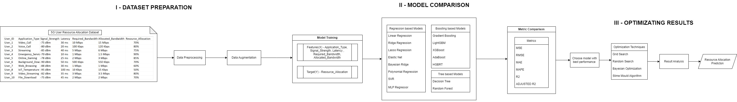
Proposed methodology – Block diagram
Continuation in next page

Slide 13
Proposed methodology – Block diagram
Continuation in next page

Slide 14

Proposed methodology – Block diagram

Slide 15
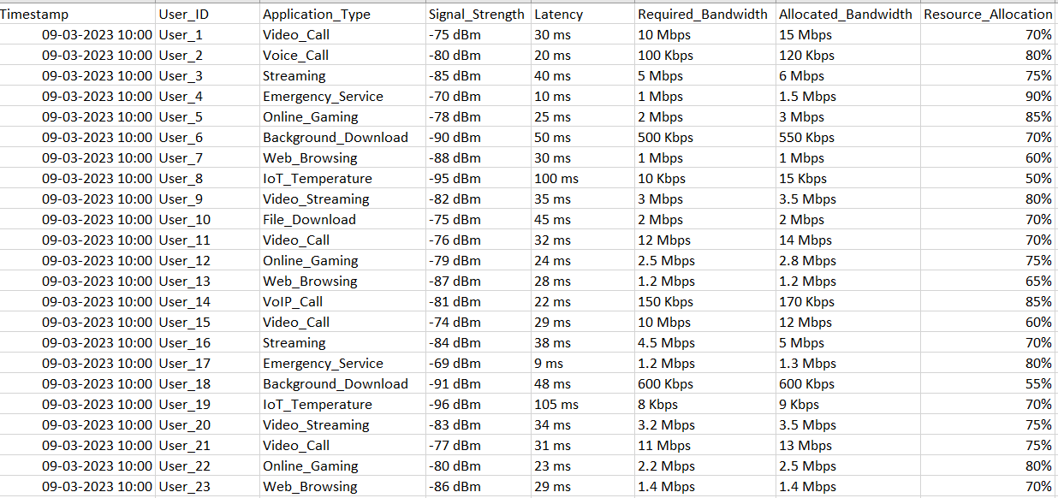
(I) Dataset preparation – Original dataset
FEATURES :
Signal_Strength: -90 dBm (weak) to -30 dBm (strong)
Application_Type: The type of application.
Latency: 0 ms (ideal) to 100 ms (realtime: 20 ms to 30 ms)
Required_Bandwidth: varies by application (eg: 5-10 Mbps - HD video streaming, 3-6 Mbps - Online Gaming)
Allocated_Bandwidth: actual bandwidth allocated (in Mbps or Kbps) exact or slightly exceed Required_Bandwidth .
Resource_Allocation: Efficiency of allocated resources given in percentage.

Slide 16
(I) Dataset preparation - Data Preprocessing
Removed Timestamp: Eliminated the Timestamp attribute.
Encoded Application Type: Applied numeric encoding to application_type.
Standardized Bandwidth: Unified units for Required_bandwidth and Allocated_bandwidth.
Stripped Symbols: Removed ‘%’, ‘dBm’, and ‘ms’ from attributes.
Refined User ID: Ensured User_Id contains only the ID
Preprocessed Dataset
User_ID | Application_Type | Signal_Strength | Latency | Required_Bandwidth | Allocated_Bandwidth | Resource_Allocation
1 | 6 | -75 | 30 | 10000 | 15000 | 70
2 | 9 | -80 | 20 | 100 | 120 | 80
3 | 5 | -85 | 40 | 5000 | 6000 | 75
4 | 1 | -70 | 10 | 1000 | 1500 | 90
5 | 4 | -78 | 25 | 2000 | 3000 | 85
6 | 0 | -90 | 50 | 500 | 550 | 70
7 | 10 | -88 | 30 | 1000 | 1000 | 60
8 | 3 | -95 | 100 | 10 | 15 | 50
9 | 7 | -82 | 35 | 3000 | 3500 | 80

Slide 17
(I) Dataset preparation - Data Augmentation
Augmented Dataset: Expanded the dataset from 400 to 16,000 records.
Equal Distribution: Ensured balanced distribution across each application_type.
Comparison of Techniques: Evaluated correlation differences for various augmentation methods, including:
Random Over Sampling
Gaussian Noise Augmentation
GAN
MLP – ANN
SMOGN
Consistency of Features: Maintained consistent average values for each feature.
Correlation Results: Observed similar correlation outcomes across all augmentation methods and used the best method with higher correlation similarity.

Slide 18
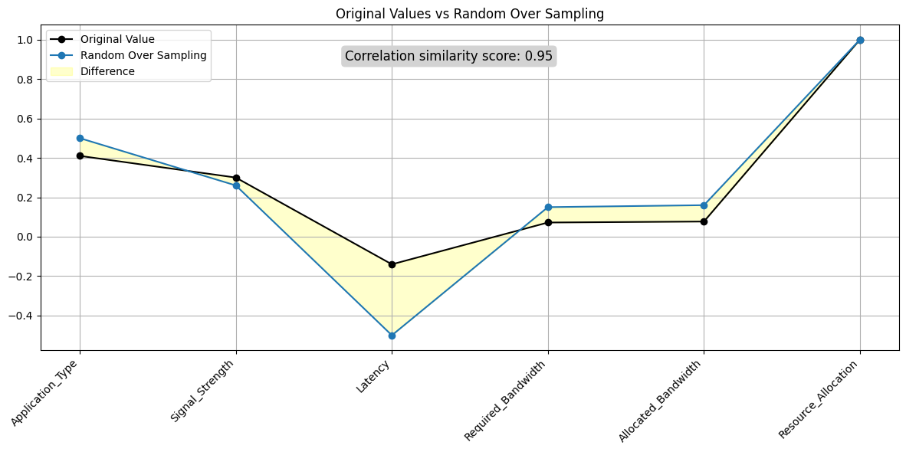
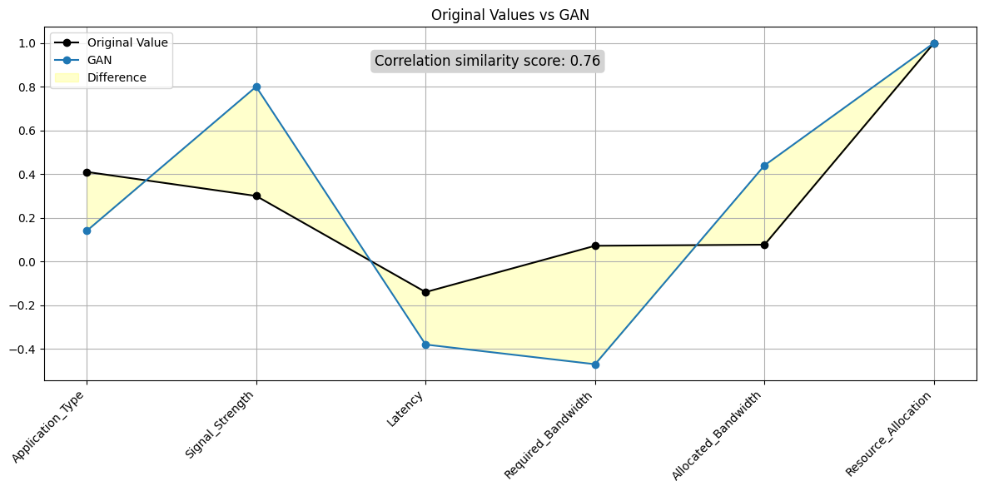
Data Augmentation – Correlation similarity with original dataset
Random Over Sampling
GAN
Random Over Sampling Correlation: 0.95
GAN Correlation: 0.76

Slide 19
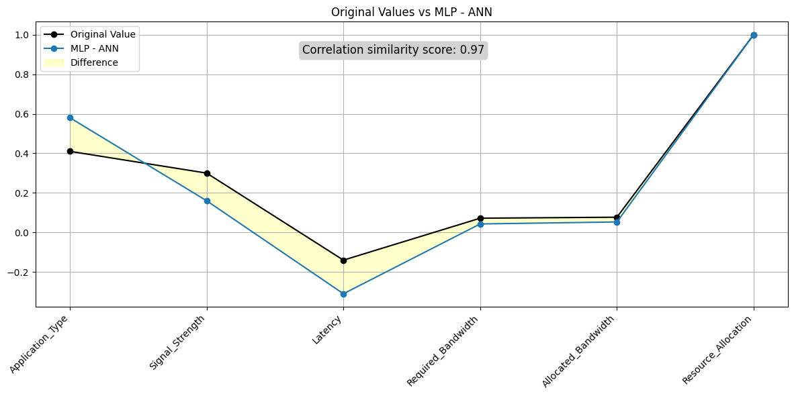
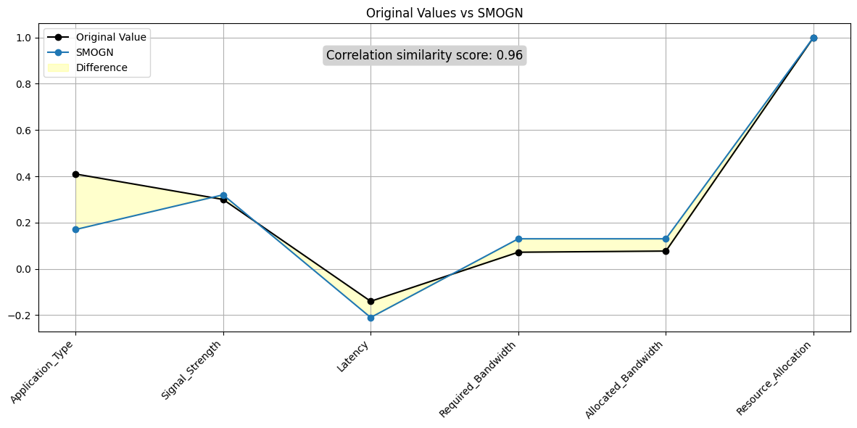
Data Augmentation – Correlation similarity with original dataset
MLP-ANN
SMOGN
MLP - ANN Correlation: 0.97
SMOGN Correlation: 0.96

Slide 20
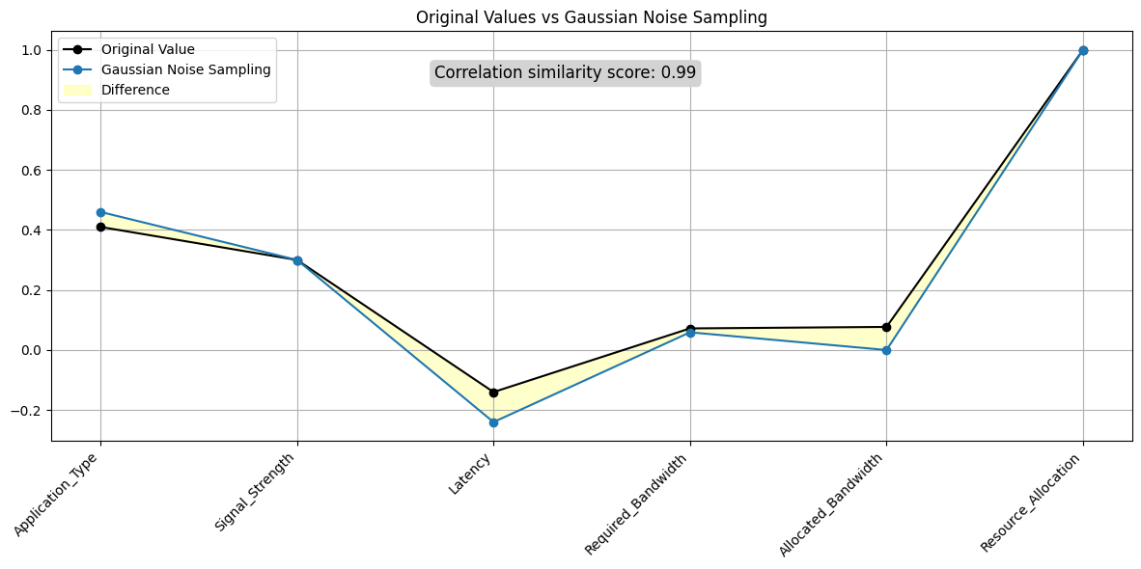
Data Augmentation – Correlation similarity with original dataset
Gaussian Noise Sampling
Augmented dataset with Gaussian Noise Sampling method gives the highest correlation similarity score – 0.99

Slide 21
Data Augmentation – Gaussian Noise Sampling
ALGORITHM -
Generate Noise: Create Gaussian noise using the formula N∼N(μ,σ2) where μ is the mean and σ is the standard deviation.
Apply Noise: Add the generated noise to the numerical features of the dataset: Noisy_Feature=Original_Feature+N
Adjust Parameters: Set μ=0 and σ based on the desired noise level (e.g., σ=0.1).
Sample Data: Randomly sample rows from the dataset to augment, ensuring balanced representation for each application category.
Concatenate: Combine the noisy, augmented data with the original dataset to create a larger, noise-augmented dataset.

Slide 22
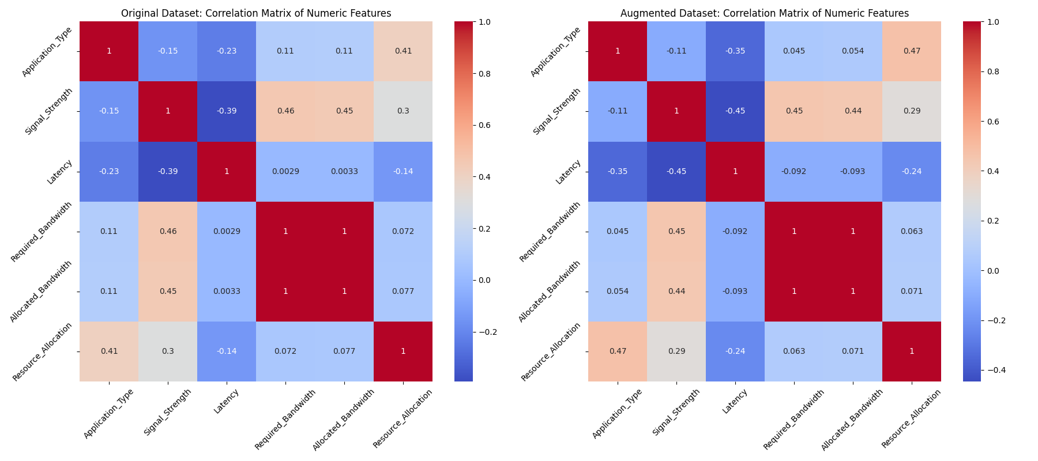
Data Augmentation - Correlation similarity with original dataset
Correlation Matrix of Original dataset vs Augmented dataset (Gaussian Noise Sampling)

Slide 23
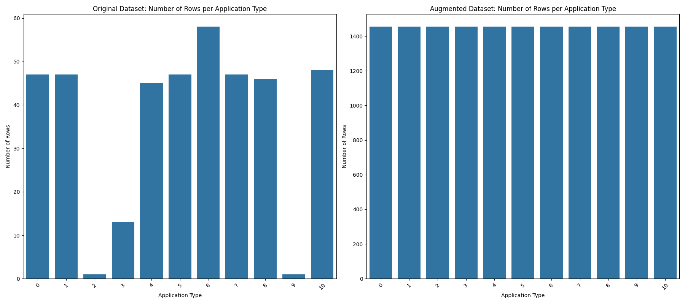
Data Augmentaion – Comparitive Analysis
Number of data in Original dataset vs Augmented dataset (Gaussian Noise Sampling)
for Each Application Type

Slide 24
(II) Model Comparison - Regression Based Models
Linear Regression: Linear Regression is a fundamental regression technique where the model predicts a continuous target variable based on a linear relationship with one or more features.
Parameters: None
➔ ŷ = β0 + β1x
Predicts the target variable ŷ as a linear combination of features x, with coefficients β0 (intercept) and β1 (slope).

Slide 25
(II) Model Comparison - Regression Based Models
Ridge Regression: Adds regularization to Linear Regression to prevent overfitting by penalizing large coefficients.
Parameters: alpha: 0.5 controls the strength of the regularization. A higher alpha increases regularization ,Lower values decrease regularization, allowing the model to fit the training data more closely.
➔ ŷ = β0 + β1x
Minimize RSS + α ∑ βi^2 and Adds L2 regularization (penalty term α ∑ βi^2) to prevent overfitting by shrinking coefficients.

Slide 26
Lasso Regression: Similar to Ridge, but with L1 regularization, which can set some coefficients to zero, effectively selecting features.
Parameters: alpha: 0.5
(II) Model Comparison - Regression Based Models
➔ ŷ = β0 + β1x
Minimize RSS + α ∑ |βi| and uses L1 regularization (penalty term α ∑ |βi|), which can shrink some coefficients to zero, promoting feature selection.

Slide 27
(II) Model Comparison - Regression Based Models
Elastic Net: Combines L1 and L2 regularization from Lasso and Ridge, balancing their benefits.
Parameters: alpha: 0.5
l1_ratio: 0.7 it determines the mix of L1 and L2 regularization. A value of 0.7 means that L1 regularization (Lasso) is more influential, leading to more feature selection compared to L2 regularization.
➔ ŷ = β0 + β1x
Minimize RSS + α (l1_ratio ∑ |βi| + (1 - l1_ratio) ∑ βi^2) and combines L1 and L2 regularization, balancing the effects of both, where l1_ratio controls the trade-off between them.

Slide 28
(II) Model Comparison - Regression Based Models
Bayesian Ridge: A probabilistic model that incorporates prior distributions into the regression analysis.
Parameters : alpha_1: 1e-6 ,alpha_2: 1e-6, lambda_1: 1e-6 , lambda_2: 1e-6 . These parameters control the prior distributions of the coefficients and their variances. Lower values (e.g., 1e-6) make the prior distributions weaker, allowing for greater flexibility in fitting the model.
➔ ŷ = β0 + β1x
Incorporates prior distributions on coefficients: RSS + prior_penalty and uses Bayesian inference with prior distributions to incorporate uncertainty in the regression coefficients.

Slide 29
(II) Model Comparison - Regression Based Models
Polynomial Regression: Extends Linear Regression by fitting a polynomial equation, capturing non-linear relationships.
Parameter : degree: 3 - specifies the degree of the polynomial features. A higher degree can capture more complex relationships but risks overfitting.
ŷ = β0 + β1x + β2x^2 + ... + βdxd
Extends Linear Regression by fitting a polynomial function of degree d, capturing more complex relationships between features and the target variable.

Slide 30
(II) Model Comparison - Regression Based Models
SVR (Support Vector Regression): Uses support vector machines to perform regression, focusing on the margins of the best fit line.
Parameters : C: 10 it controls the trade-off between smoothness and accuracy.
epsilon: 0.1 defines the margin within which errors are tolerated.
kernel: 'rbf’ defines the function used to map the data into a higher-dimensional space..
ŷ = ∑ αi (yi - b) K(xi, x)
Minimize RSS + C ∑ ξi subject to |yi - ŷi| ≤ ε + ξi and uses a kernel function K(xi, x) to map input data into a higher-dimensional space, focusing on fitting the data within a margin of tolerance ε.

Slide 31
(II) Model Comparison - Regression Based Models
MLP Regressor: A neural network-based regressor that can capture complex, non-linear relationships
Parameters: hidden_layer_sizes: (100,) defines the number and size of hidden layers in the neural network. More layers or neurons can capture more complex patterns but increase the risk of overfitting.
activation: 'relu' specifies the activation function used in the neurons.
solver: ‘adam’ determines the optimization algorithm used for training the network.
ŷ = f(hidden_layers(x))
Uses neural networks with multiple hidden layers and activation functions to model complex, non-linear relationships.

Slide 32
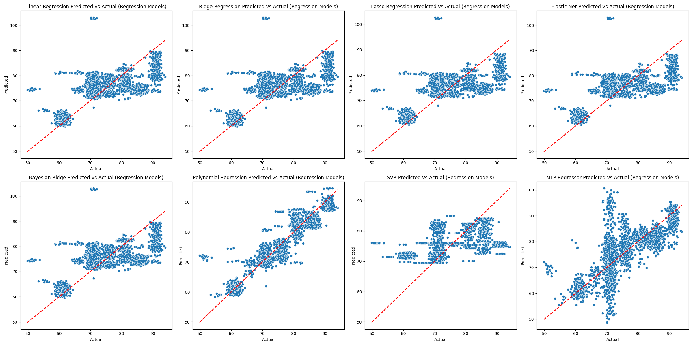
Regression models - Actual vs Predicted
Scatter plot graph of Regression Models

Slide 33
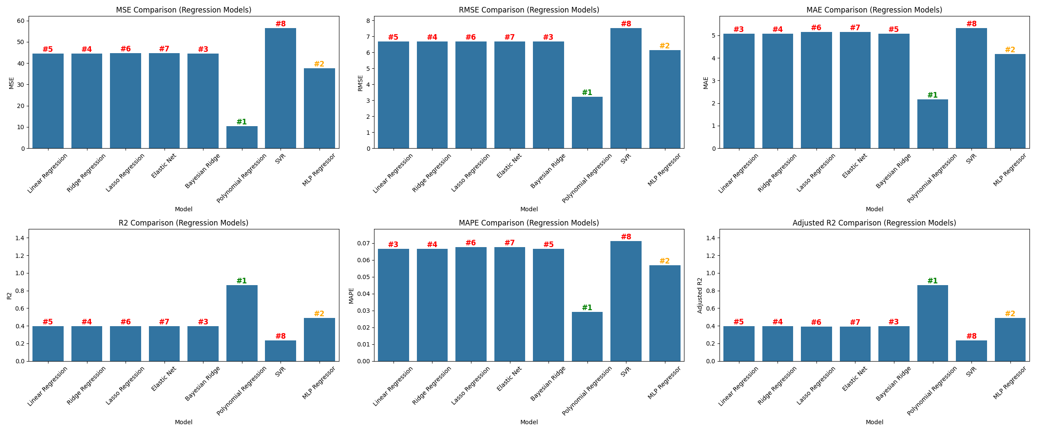
Regression models – Metric comparison
Metric Comparison of Regression Models (Best – Polynomial regression)

Slide 34
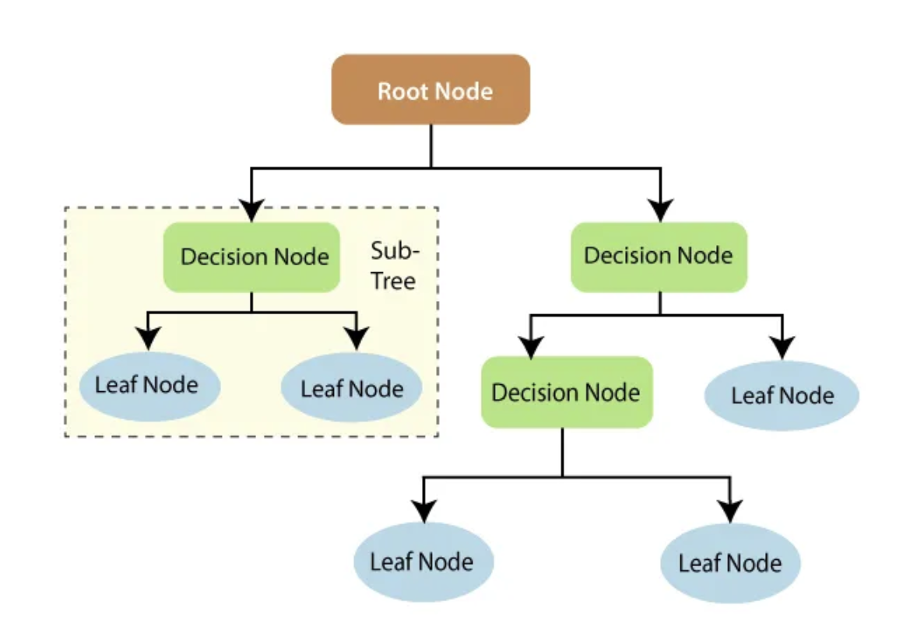
(II) Model Comparison - Tree Based Models
Decision Tree Regressor: Recursively split data based on the feature that maximizes the information gain or minimizes impurity until a stopping criterion is met.
Parameters : max_depth: 10 limits the maximum depth of the tree.
min_samples_split: 5 specifies the minimum number of samples required to split an internal node.
min_samples_leaf: 2 defines the minimum number of samples required to be at a leaf node.

Slide 35
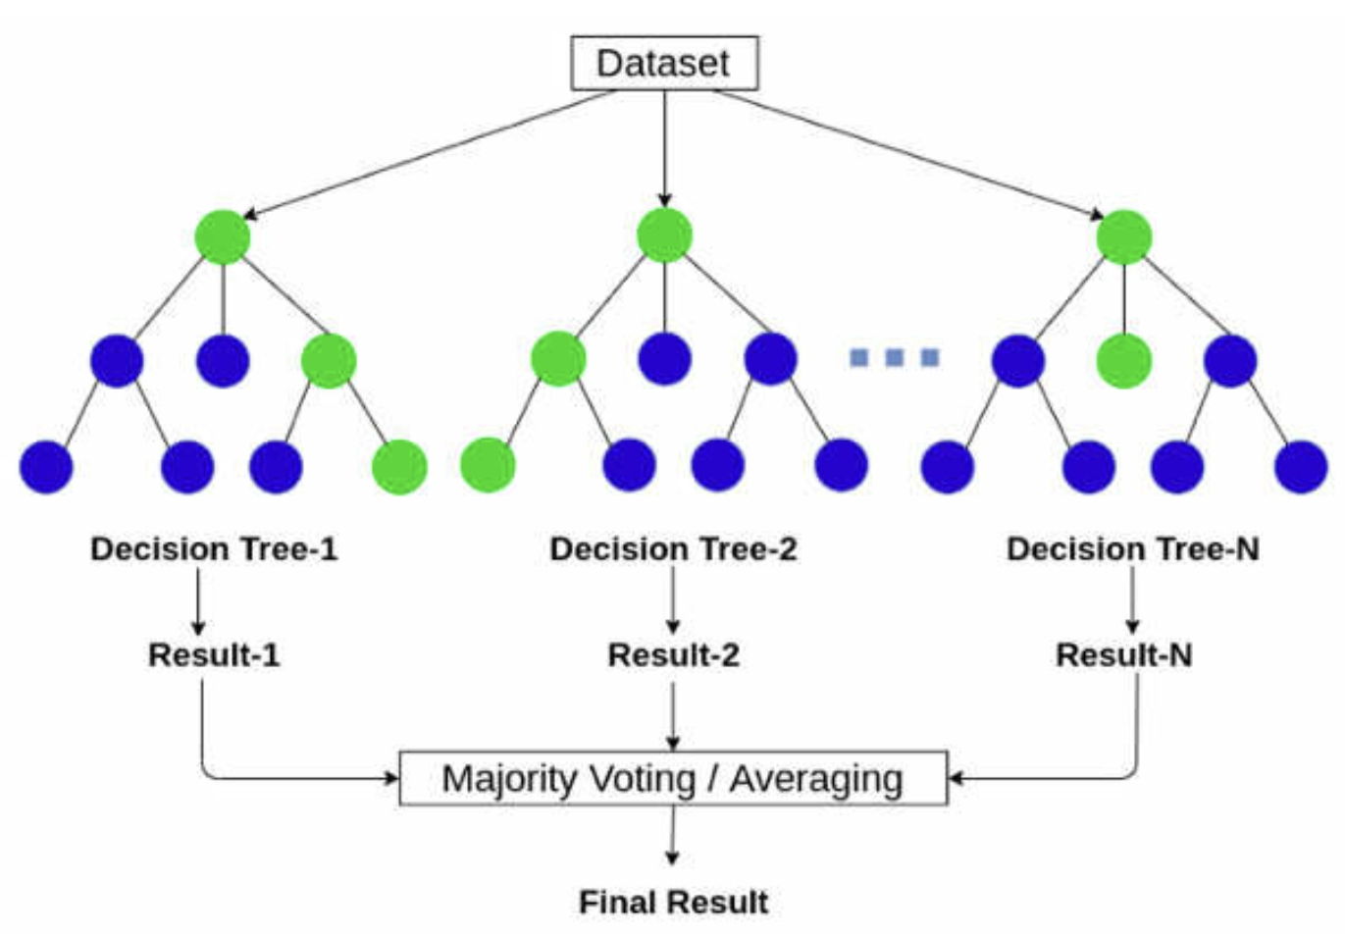
(II) Model Comparison - Tree Based Models
Random Forest Regressor: An ensemble method that uses multiple decision trees to improve predictive accuracy and control overfitting.
Parameters: n_estimators: 200 defines the number of trees in the forest.
max_depth: 20 limits the depth of individual trees in the forest.
min_samples_split: 10 controls the minimum number of samples required to split an internal node.

Slide 36
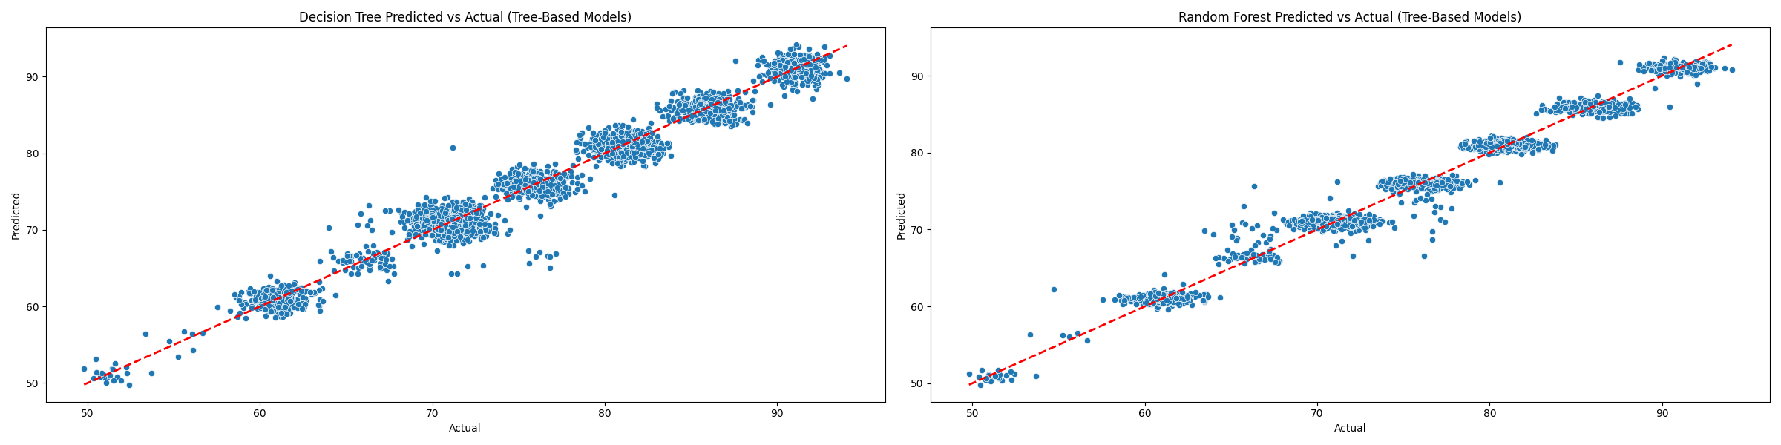
Tree based models – Actual vs Predicted
Scatter Plot Graph of Tree Based Models

Slide 37
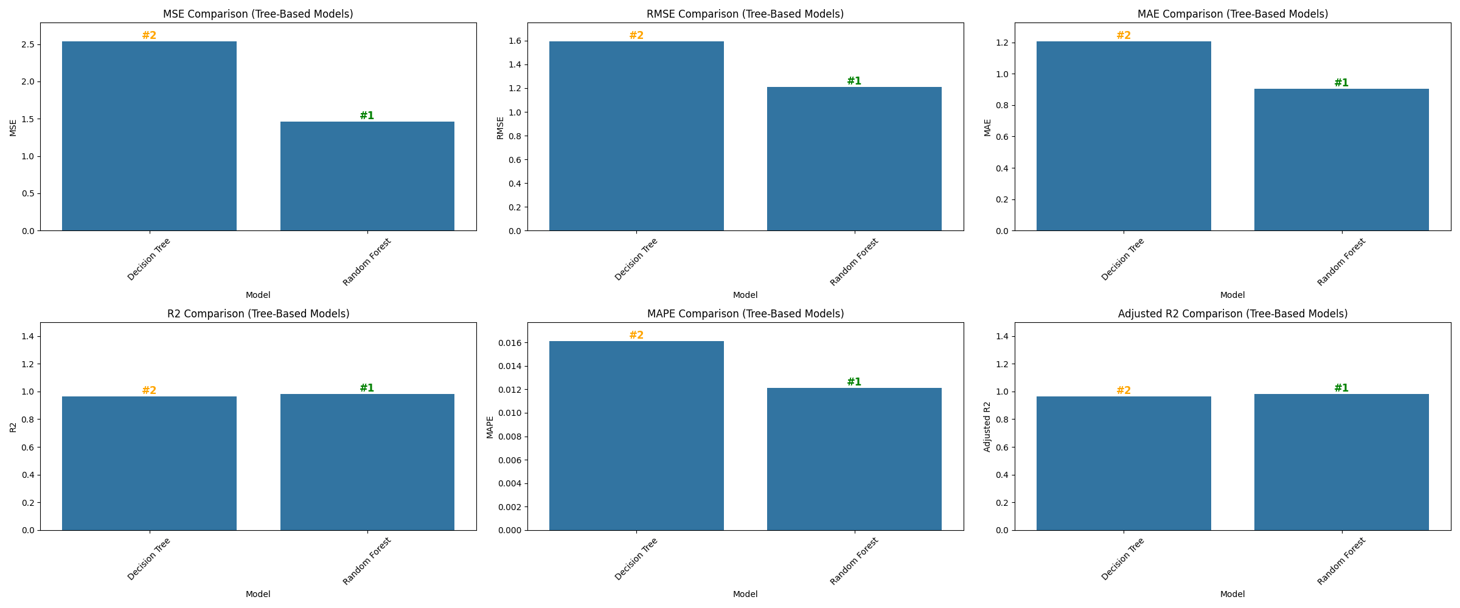
Tree based models – Metrics Comparison
Metric Comparison of Tree Based Model (Best – Random forest)

Slide 38
(II) Model Comparison – Boosting based Models
Gradient Boosting Regressor: Sequentially builds models by focusing on the errors of the previous ones, enhancing performance.
Parameters : n_estimators: 150 defines the number of boosting stages. More stages can improve model performance but increase training time.
learning_rate: 0.1 controls the contribution of each boosting stage. A lower rate requires more stages to achieve the same performance but can lead to better results.
max_depth: 5 limits the depth of each individual tree. It controls the complexity of each tree and helps prevent overfitting.

Slide 39
(II) Model Comparison – Gradient Boosting Regressor
Initialize: Start with a base model F_0(x).
Iterative Improvement: For each stage t, fit a model to the residuals
Residuals: r_i^{(t)} = y_i - F_{t-1}(x_i)
y_i: Actual target value
F_{t-1}(x_i): Predicted value from the previous stage
3. Update: F_t(x) = F_{t-1}(x) + \alpha \cdot h_t(x)
α: Learning rate (controls contribution of each stage)
h_t(x): Model fitted to residuals at stage t3.
4. Combine Models: Aggregate predictions from all stages.
ALGORITHM →

Slide 40
(II) Model Comparison – Boosting based Models
AdaBoost Regressor: Adjusts the weights of incorrectly predicted instances to improve model accuracy.
Parameters : n_estimators: 100 defines the number of boosting stages. More stages generally improve performance but require more training time.
learning_rate: 0.1 controls the contribution of each boosting stage. A lower rate increases the number of stages needed but can lead to better model performance.

Slide 41
(II) Model Comparison – AdaBoosting Regressor
Initialize: Start with a base model F_0(x).
Iterative Update: For each stage t, adjust weights of samples
- Update Weights: w_i^{(t)} = w_i^{(t-1)} \cdot exp(\alpha_t \cdot (y_i - F_{t-1}(x_i))^2)
w_i^{(t)}: Weight of sample i at stage t
α_t: Weight update factor for stage t
- Model Update: F_t(x) = F_{t-1}(x) + \alpha_t \cdot h_t(x)
α_t: Learning rate for stage t
h_t(x)*: Model fitted to residuals at stage t
3. Combine Models: Aggregate weight predictions from all stages.
ALGORITHM →

Slide 42
(II) Model Comparison – Boosting based Models
XGBoost: An optimized version of Gradient Boosting that is efficient and widely used in competitive machine learning.
Parameters : n_estimators: 100 defines the number of boosting stages. More stages can improve performance but increase training time.
learning_rate: 0.1 controls the contribution of each boosting stage. Lower values improve performance but may require more stages.
max_depth: 6 limits the depth of individual trees. It helps control overfitting by limiting the complexity of each tree.

Slide 43
(II) Model Comparison – XGBoost
Initialize: Start with a base model F_0(x).
2. Iterative Refinement: For each stage t, fit a model to residuals:
- Objective Function: Minimize L(F) + Ω(F)
L(F): Loss function (measures prediction error)
Ω(F): Regularization term (controls model complexity)
- Residuals: r_i^{(t)} = y_i - F_{t-1}(x_i)
y_i: Actual target value
F_{t-1}(x_i): Predicted value from the previous stage
3. Update: F_t(x) = F_{t-1}(x) + \alpha \cdot h_t(x)
α: Learning rate (controls contribution of each stage)
h_t(x)*: Model fitted to residuals at stage t
4. Combine Models: Aggregate predictions from all stages.
ALGORITHM →

Slide 44
(II) Model Comparison – Boosting based Models
LightGBM: A fast, efficient boosting model that works well with large datasets by using a leaf-wise tree growth algorithm.
Parameters : n_estimators: 150 defines the number of boosting stages. More stages generally improve model performance but increase training time.
learning_rate: 0.1 controls the contribution of each boosting stage. Lower values can lead to better performance but require more stages.
max_depth: 5 limits the depth of trees, controlling model complexity and overfitting.
num_leaves: 31 controls the complexity of each tree. More leaves allow the model to capture more details but can lead to overfitting.

Slide 45
(II) Model Comparison – LightGBM
Initialize: Start with a base model F_0(x).
2. Leaf-wise Growth: Fit trees using leaf-wise splits and minimize
- Objective Function: Minimize L(F) + λ · Complexity
L(F): Loss function (measures prediction error)
λ: Regularization parameter (controls complexity)
- Residuals: r_i^{(t)} = y_i - F_{t-1}(x_i)
y_i: Actual target value
F_{t-1}(x_i): Predicted value from the previous stage
3. Update: For each stage t, add a new tree to the model
- Model Update: F_t(x) = F_{t-1}(x) + α · h_t(x)
α: Learning rate (controls contribution of each stage)
h_t(x): Tree fitted to residuals at stage t
4. Combine Models: Aggregate predictions from all stages.
ALGORITHM →

Slide 46
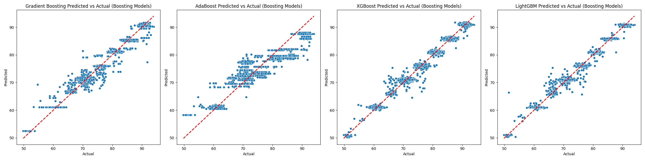
Boosting models– Actual vs Predicted
Scatter Plot Graph of Boosting Model.

Slide 47
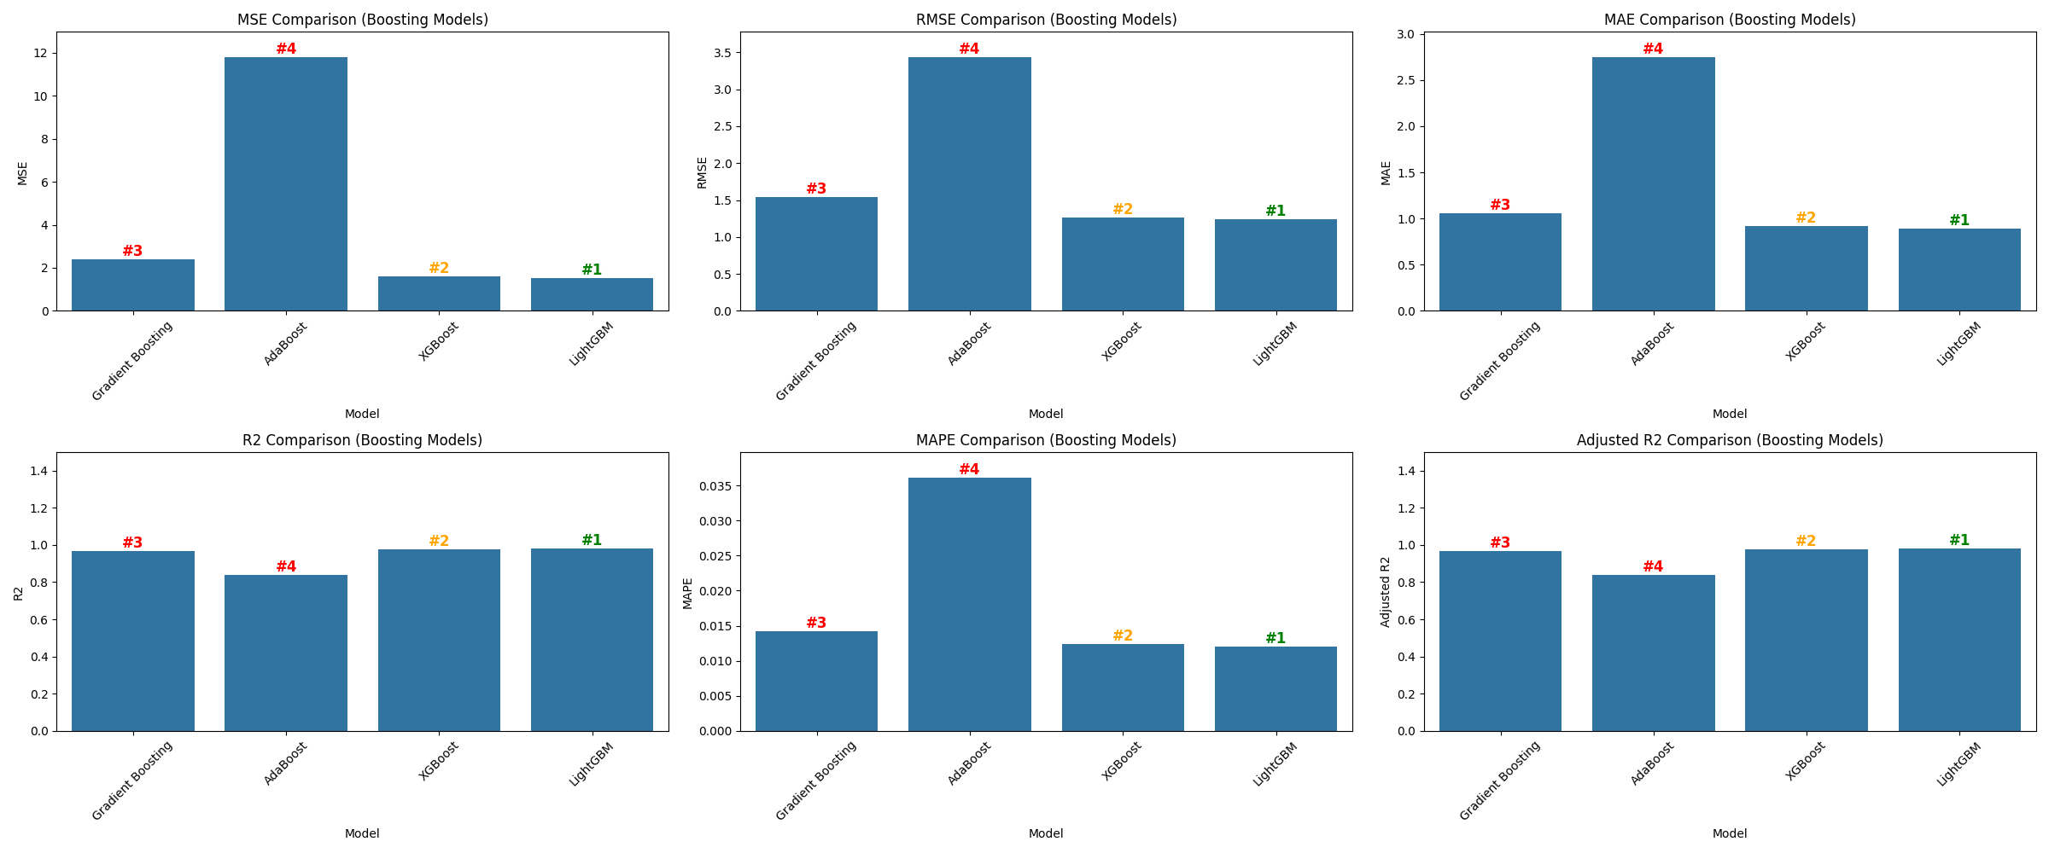
Boosting models – Metrics Comparison
Metric comparison of Boosting based Models(Best – LightGBM)

Slide 48
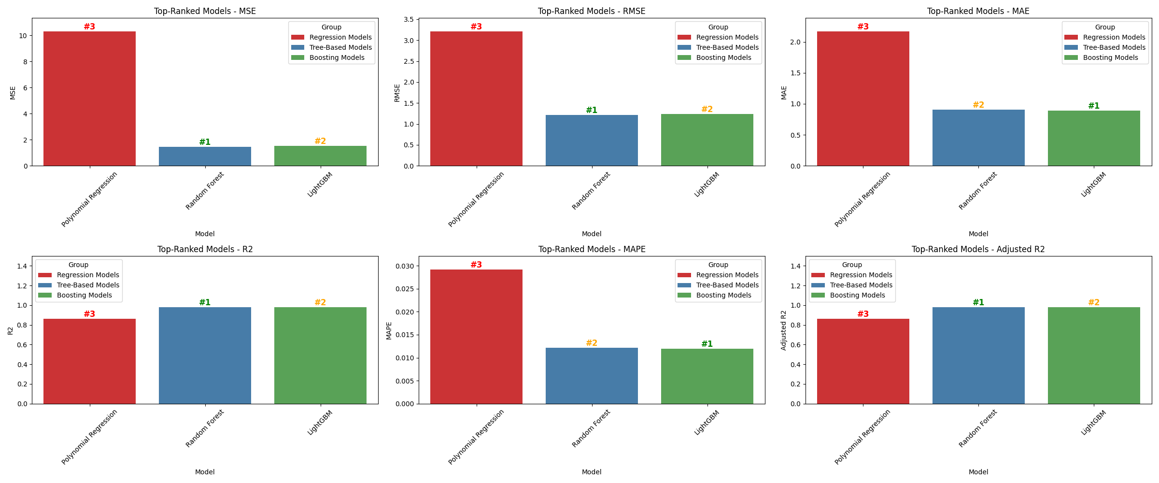
Consolidated model comparison
Consolidated metric Comparison of the Best model from Regression-based, Tree-based, and Boosting Models.

Slide 49
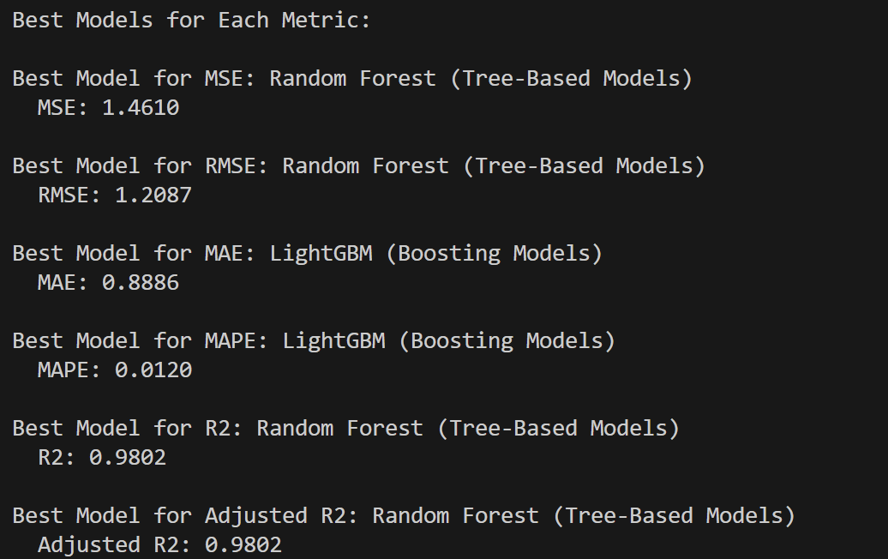
Consolidated model comparison
Best models for various metrics across Regression-based, Tree-based, and Boosting models.

Slide 50
Model Selection - HGBRT
HISTOGRAM-BASED GRADIENT BOOSTING REGRESSION TREE (H-GBRT)
Histogram-based Gradient Boosting Regression Trees (HGBRT) is a machine learning algorithm that builds multiple decision trees using a technique called boosting. It partitions continuous features into discrete bins (histograms) to speed up training and improve efficiency. HGBRT is particularly effective for large datasets due to its scalability and robust performance.
Boosting Framework: Sequentially builds models to correct errors of previous ones, enhancing performance.
Histogram-based Approach: Partitions continuous features into discrete bins to reduce complexity. , reduces memory usage and speeds up training, ideal for large datasets.
Tree Construction: Expands trees level-by-level, using histogram approximations for splits and controls overfitting with parameters limiting tree depth and complexity.
Scalability: Handles large-scale data efficiently with built-in support for missing values and parallel processing.

Slide 51
HGBRT vs Previous best performing models
HGBRT vs. LightGBM:
Growth Strategy: HGBRT uses level-wise tree growth which is more stable, whereas LightGBM uses leaf-wise growth, which can lead to better performance but also a higher risk of overfitting.
Feature Binning: HGBRT's binning process can lead to faster computations and reduced memory usage, which may offer advantages in scenarios with extremely large datasets.
HGBRT vs. Random Forest:
Boosting vs. Bagging: HGBRT employs boosting, which sequentially corrects errors from previous models, generally offering better performance and generalization compared to Random Forest’s bagging approach, which builds trees independently and averages their results.
Training Efficiency: HGBRT’s histogram-based approach can be faster and more efficient in training than Random Forest’s multiple independent tree construction.

Slide 52
(III) Optimizing results – Parameter Optimization
Grid Search: Exhaustively evaluates all possible combinations of specified hyperparameter values. Simple but computationally intensive.
Random Search: Randomly samples hyperparameters from specified distributions, offering a more efficient alternative to Grid Search for large spaces.
Bayesian Optimization: Uses probabilistic models to intelligently explore the hyperparameter space, focusing on promising areas based on prior evaluations.
Genetic Algorithms: Applies evolutionary strategies to iteratively improve hyperparameter sets, simulating natural selection processes.
Gradient-Based Optimization: Description: Utilizes gradients of the performance metric with respect to hyperparameters to guide the optimization process, applicable when gradients can be computed.

Slide 53
(III) Optimizing results– Parameter Optimization
Slime Mould Algorithm (SMO):
It is inspired by the behavior of slime moulds in nature, particularly their foraging strategies. It simulates the adaptive search for nutrients and efficient paths as the slime mould spreads and finds optimal food sources. By emulating this natural process, SMO dynamically balances exploration and exploitation of the parameter space. This adaptability allows SMO to efficiently handle complex, high-dimensional optimization problems. It excels in avoiding local optima and converging towards global solutions due to its unique search and adaptation mechanisms.
Dynamic Adaptation: Unlike static methods, SMO continuously adapts its search strategy based on the problem landscape, making it more versatile in complex scenarios.
Efficient Exploration: SMO effectively explores large and intricate parameter spaces by mimicking the slime mould's efficient foraging behavior, reducing the risk of local optima.
Robust Performance: Its bio-inspired approach provides robustness in diverse optimization problems, outperforming traditional methods that may struggle with high-dimensional or non-linear spaces.

Slide 54
Conclusion

Slide 55
Requirements
Hardware Requirements:
Processor: Intel i5 series
RAM: 8 GB
GPU: 4 GB
Software Requirements:
Operating System: Windows 10,11, MacOS
Coding Language: Python
Packages: Keras, Torch, Matplotlib, Tensorflow, Random, Pandas, Scikit-learn, NumPy
IDE: Google Colaboratory, Visual Studio Code

Slide 56

Timeline chart: -
Work done
Works Assigned
Works to be done

Slide 57
References: -
Gao Z. 5G Traffic Prediction Based on Deep Learning. Comput Intell Neurosci. 2022 Jun 24;2022:3174530. doi: 10.1155/2022/3174530. PMID: 35785055; PMCID: PMC9249458.
Zamzami, Ikhlas. (2022). Deep Learning Models Applied to Prediction of 5G Technology Adoption. Applied Sciences. 13. 119. 10.3390/app13010119.
L. Li and T. Ye, "Research on throughput prediction of 5G network based on LSTM," in Intelligent and Converged Networks, vol. 3, no. 2, pp. 217-227, June 2022, doi: 10.23919/ICN.2022.0006Qin, Z., Weng, J., Cui, Y., & Ren, K. Privacy-preserving image processing in the cloud. IEEE Cloud Computing (2018).
Subramani, N.; Veerappampalayam Easwaramoorthy, S.; Mohan, P.; Subramanian, M.; Sambath, V. A Gradient Boosted Decision Tree-Based Influencer Prediction in Social Network Analysis. Big Data Cogn. Comput. 2023, 7, 6.
Guryanov, A. (2019). Histogram-Based Algorithm for Building Gradient Boosting Ensembles of Piecewise Linear Decision Trees. In: van der Aalst, W., et al. Analysis of Images, Social Networks and Texts. AIST 2019. Lecture Notes in Computer Science(), vol 11832. Springer, Cham.

Slide 58
References: -
Gharehchopogh, F.S., Ucan, A., Ibrikci, T. et al. Slime Mould Algorithm: A Comprehensive Survey of Its Variants and Applications. Arch Computat Methods Eng 30, 2683–2723 (2023).
Jia Wu, Xiu-Yun Chen, Hao Zhang, Li-Dong Xiong, Hang Lei, Si-Hao Deng, Hyperparameter Optimization for Machine Learning Models Based on Bayesian Optimization, Journal of Electronic Science and Technology, Volume 17, Issue 1, 2019, Pages 26-40, ISSN 1674-862X.
Gochhait, S., & Sharma, D. . (2023). Regression Model-Based Short-Term Load Forecasting for Load Despatch Centre. Journal of Applied Engineering and Technological Science (JAETS), 4(2), 693–710.

Slide 59
THANK YOU!

